Slide 1
MODERN SUPERJET SERVICES
PROJECT SUPERVISOR:
DR. NORA NIAZY
SUPERVISOR ASSISTANT:
ENG. MINA FOKEH

Slide 2
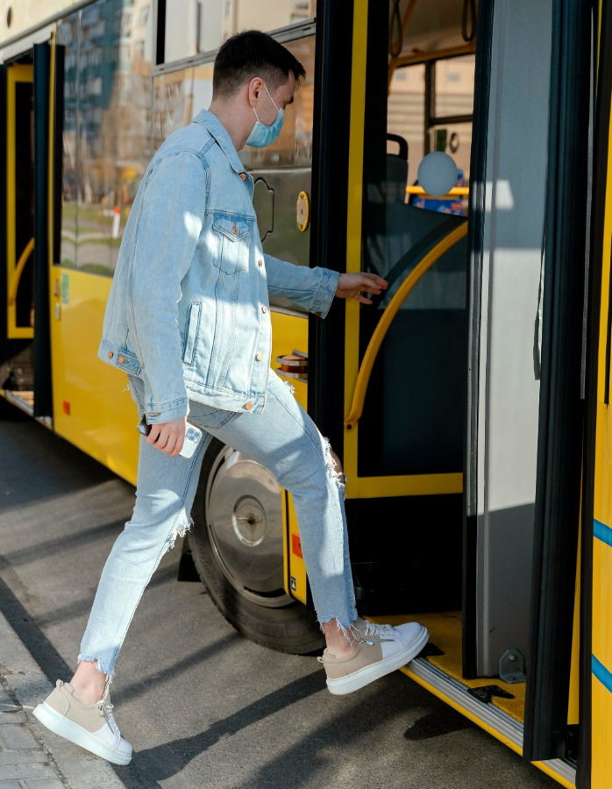
OUR TEAM
Aya Abd-elhady Mariam Hosny
Asmaa Ahmed Mariam Salama
Mariam Ahmed Mariam Mohamed
TEAM
LEADER

Slide 3

AGENDA
INTRODUCTION
TOOLS AND OUTPUT
PROBLEM AND OUR SOLUTION
FUTURE WORK
SYSTEM DESIGN

Slide 4
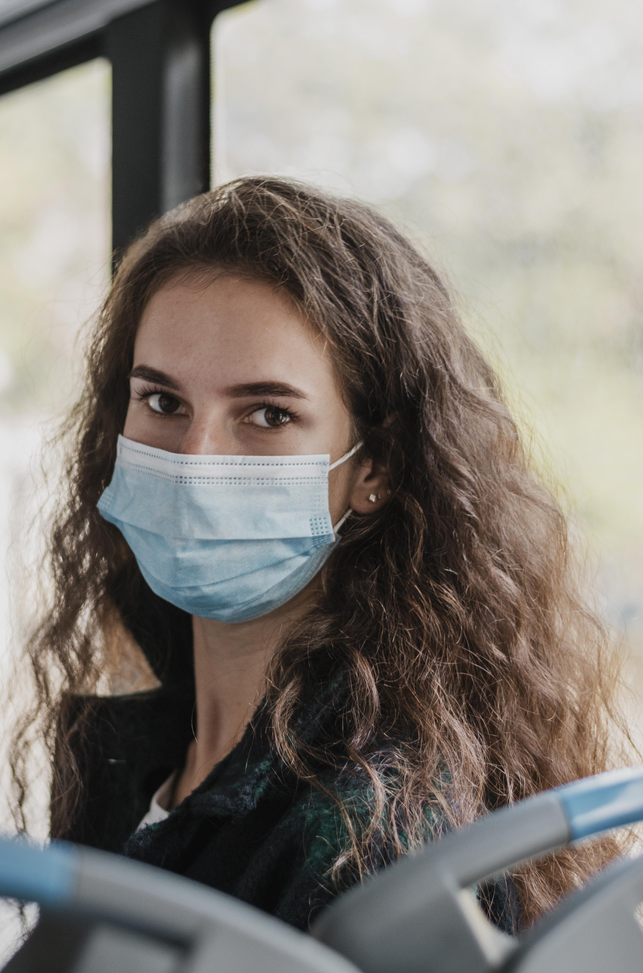
ABSTRACT
Our project solves a real problem that exists in the world and at the same time, the problem must be related to the crisis of the spread of the Corona virus so that we can accompany foreign countries in solving the problems related to this epidemic. And to change our country to smart country and every agency use digital devices.

Slide 5
PROBLEM
The Corona virus has infected many people, as it was difficult to move from one place to another under the current conditions, but our project will facilitate travel comfortably and safely, taking good precautionary measures and obligating passengers to wear a muzzle.

Slide 6
OUR SOLUTION
Online Bus Ticket System being a web based system and mobile application that ensures that the user would be able to transform most of the processes carried out manually into automated, error-free and easy to use operations in the organization especially in the area of transportation.
Also To mitigate the spread of COVID-19 pandemic, measures must be taken. We have modeled a face mask detector on door system to obligate everyone to take precautionary measures and keep them safe.
The user is given a unique QR code consisting of the ticket data, and the code is scanned to ensure that it is registered.
Part of the project is intelligent system that consists of two main controllers for driver system, GPS are designed smartly to find the shortest path of the drop off location, the system algorithm are trained individually and then collected to gathers to produce one intelligent system that has the ability to reduce the congestion of the traffic at the rest point.

Slide 7
SYSTEM DESIGN

Slide 8
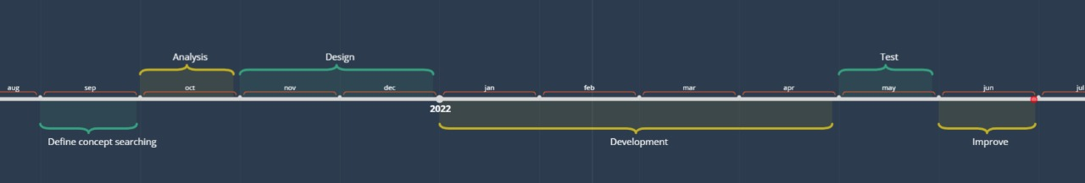
6. REVIEW & LAUNCH
1. PLAN
AGILE
DEVELOPMENT
5.
DEPLOY
2.
DESIGN
3.
DEVELOPMENT
4. TEST
TIME PLAN

Slide 9
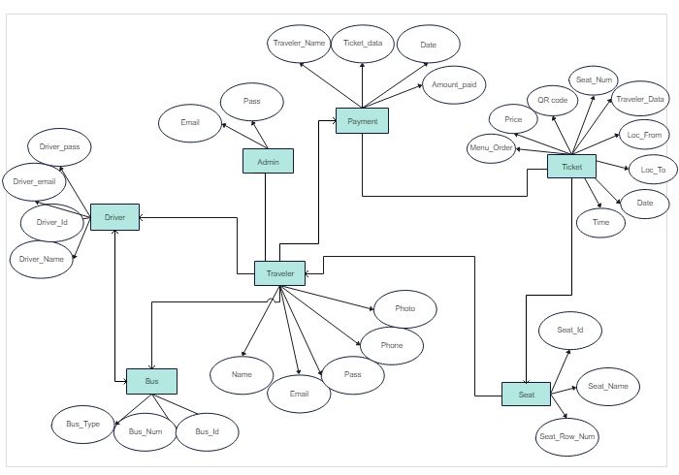
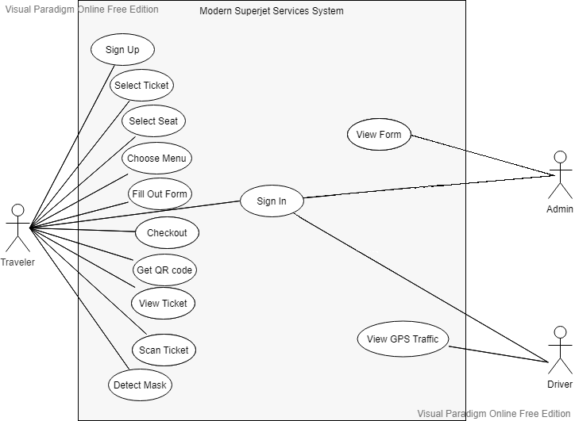
ERD
USE CASE

Slide 10
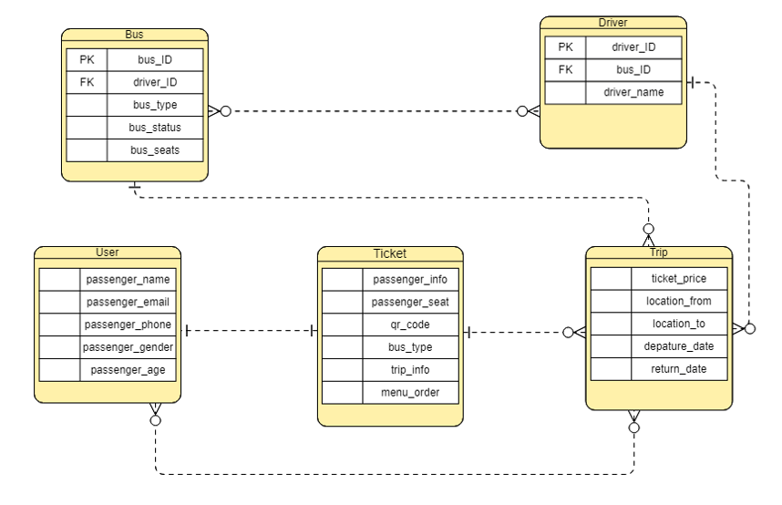
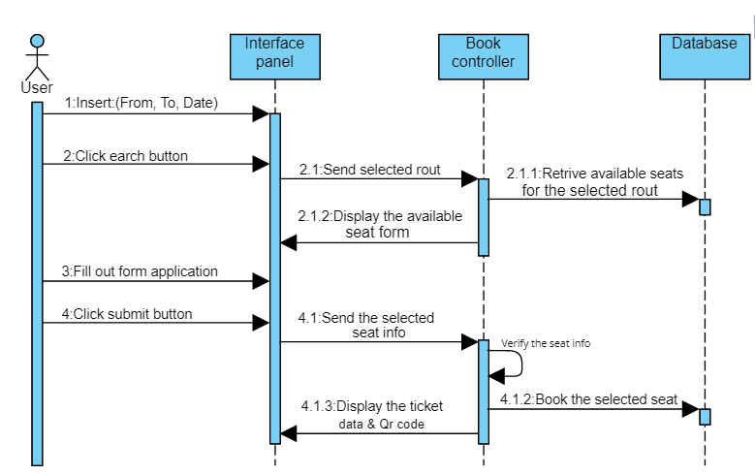
SCHEMA OF DATABASE
SEQUENCE DIAGRAM

Slide 11
TOOLS AND OUTPUT

Slide 12
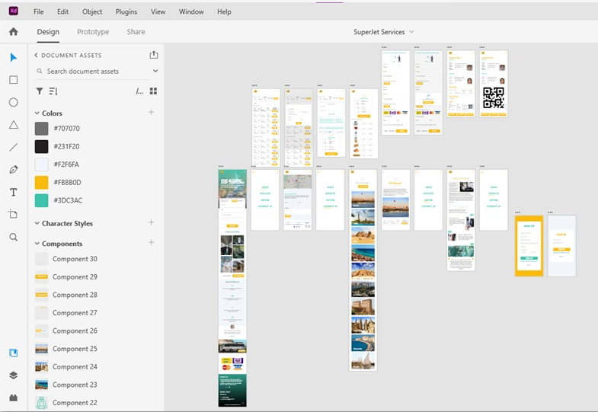

UX/UI DESIGN
Using ADOBE XD
This Program Provides:
- Padding & Animating
- Components & States
- Shareable Libraries
- Plugins
- Prototype

Slide 13




WEB DEVELOPMENT
FRONT-END
HTML
CSS
JAVASCRIPT
BACK-END
PHP
MYSQL
LARAVEL

Slide 14

APPLICATION DEVELOPMENT
FLUTTER
One code on cross-platform application.
Performance problem
Fast: Bug Fixing
High productivity: save both time and resources.
Open Source
Great performance: Reactive Views, Widgets and materials

Slide 15



APPLICATION DEVELOPMENT
Tools & Techniques
Android Studio , IntelliJ
Visual Studio Code
DevTools
Dart
Flutter SDK
Hot Reload
Flutter Fix
Code Formatting

Slide 16
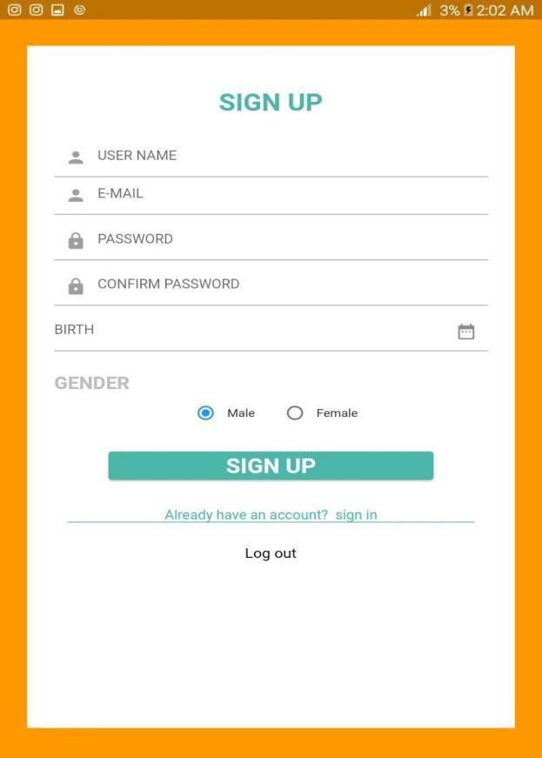
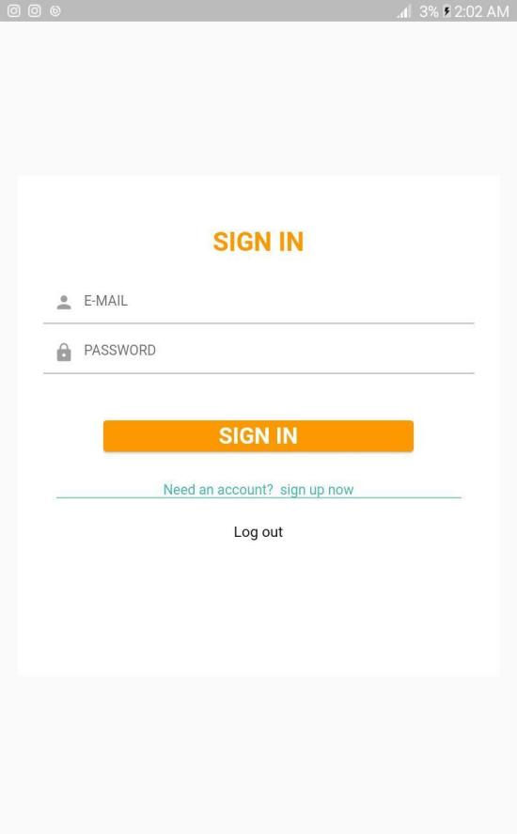
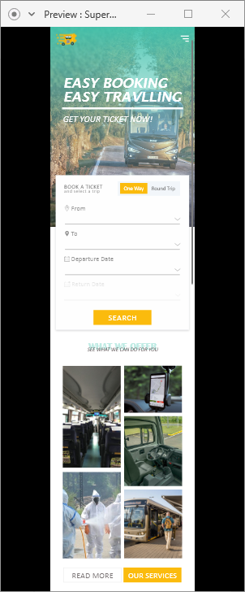
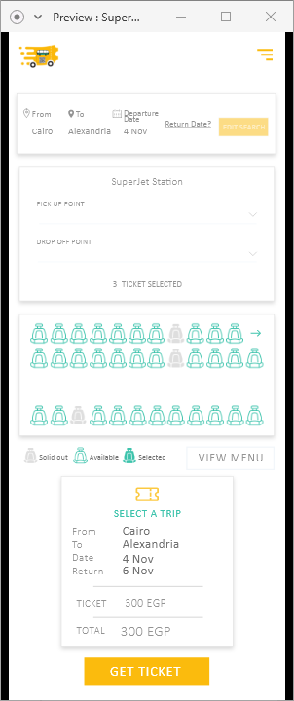
APPLICATION DEVELOPMENT

Slide 17
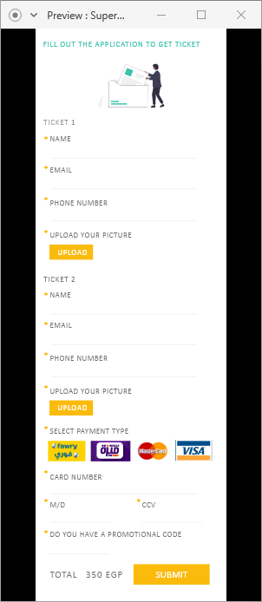
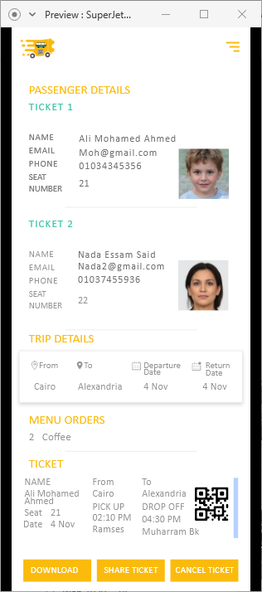
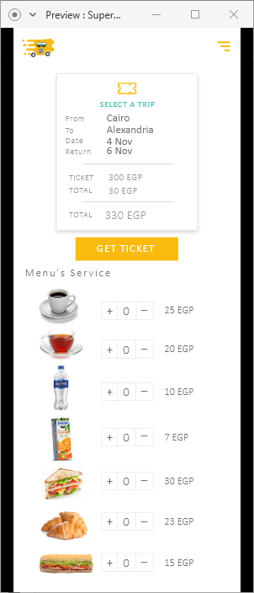
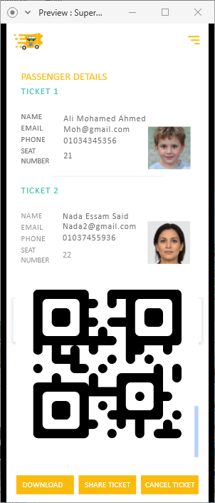

Slide 18
AI – QR SCANNER
Mask Detection
Programming Language :
Scanning QR Code
OpenCV
pyzbar
Python
Python IDE :Spyder
Deep Learning Framework – Tensorflow, keras.
Convolutional neural network architecture:MobileNetV2

Slide 19
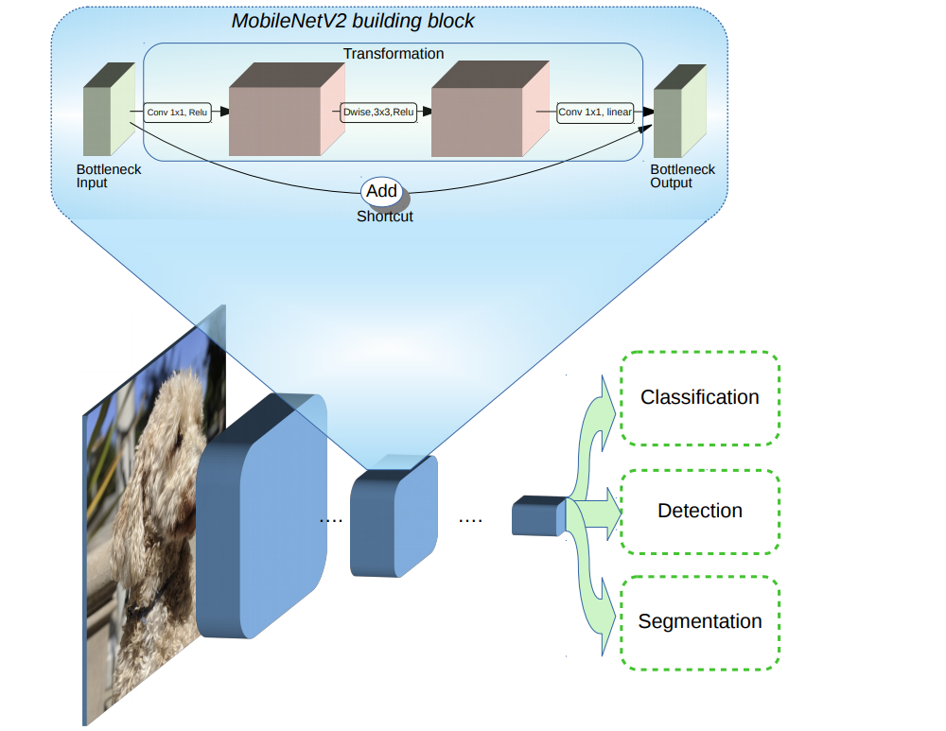
MobileNetV2
MobileNetV2 is a convolutional neural network architecture that seeks to perform well on mobile devices. It is based on an inverted residual structure where the residual connections are between the bottleneck layers. The intermediate expansion layer uses lightweight depthwise convolutions to filter features as a source of non-linearity. As a whole, the architecture of MobileNetV2 contains the initial fully convolution layer with 32 filters, followed by 19 residual bottleneck layers.

Slide 20
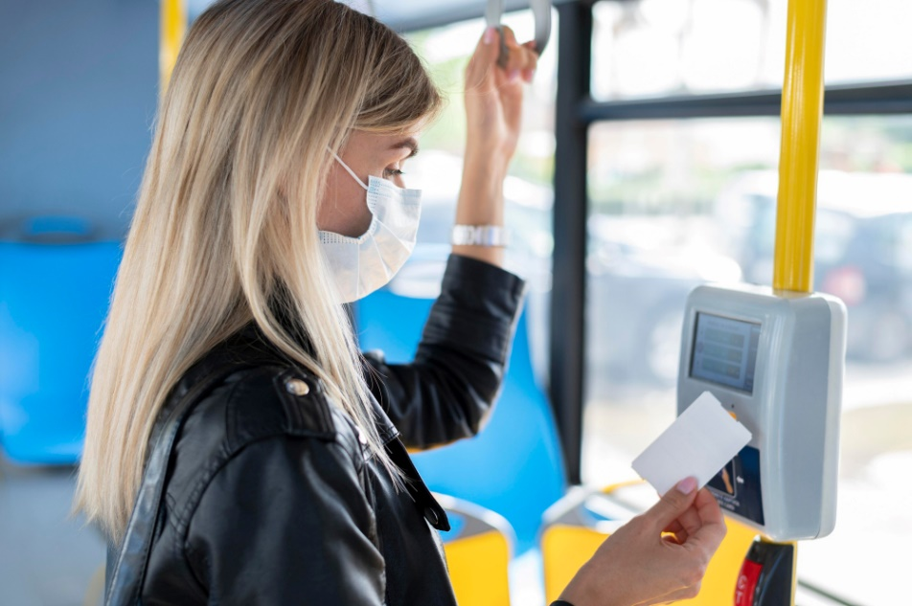
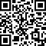
AI MASK – QR SCANNER
When the passenger arrives on the bus, he will need to scan the ticket code , then we will make sure that the person is wearing the mask to enter the bus. The first step to recognize the presence of a mask on the face is:
1. detect the face
2.detect masks on those faces.

Slide 21

EMBEDED COMPONENT
Servo
WebCam
Buzzer
LCD
Arduino Uno.
64-bit processor
Power Supply
Leds

Slide 22
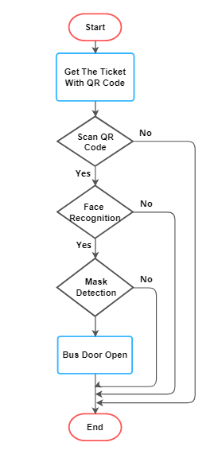
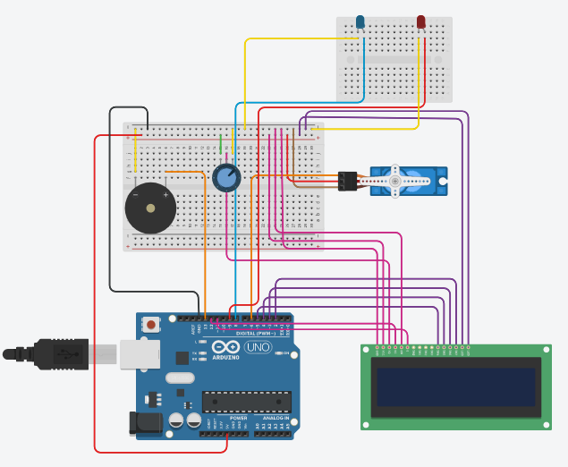

Slide 23
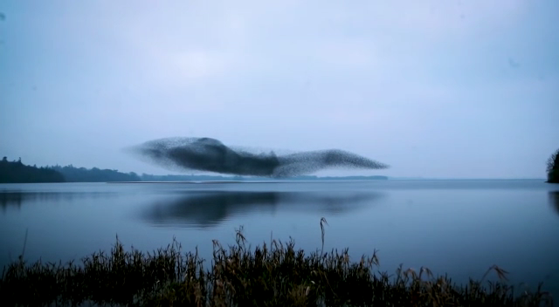
GPS & SWARM
Swarm:
Programming Language : Matlab
intelligent optimization algorithm: Particle Swarm Optimization (PSO)

Slide 24
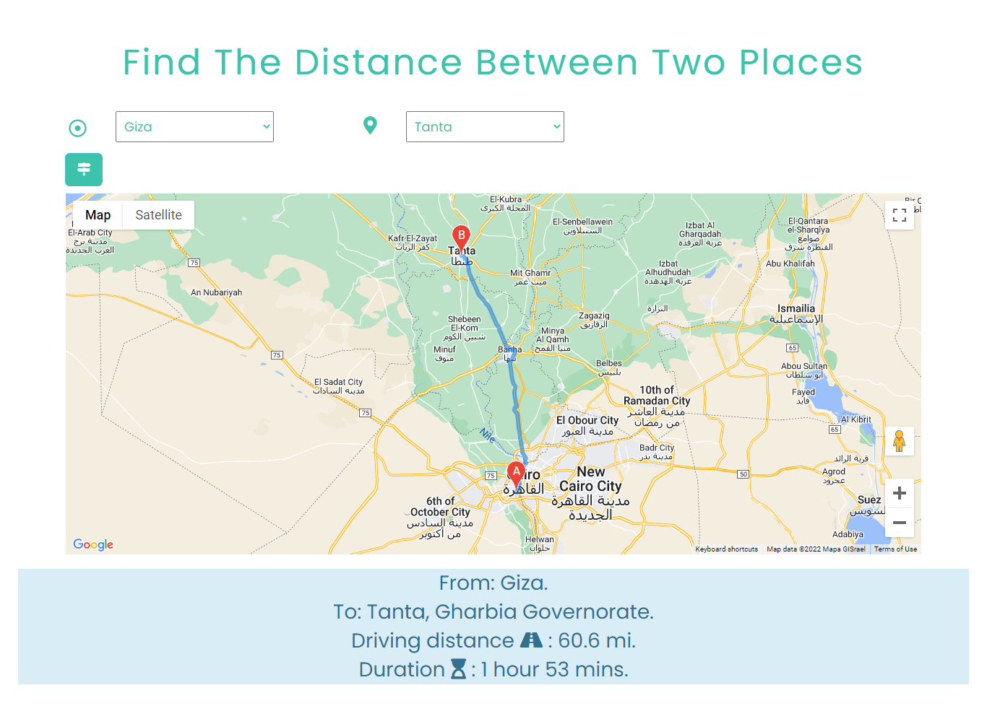
GPS

Slide 25
FUTURE WORK

Slide 26
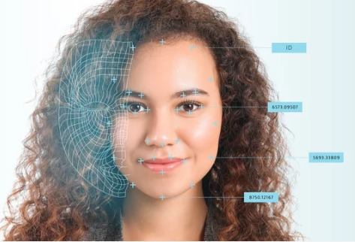
FACE RECOGNITION
Face verification is the task of comparing a candidate face to another, and verifying whether it is a match. It is a one-to-one mapping: you have to check if this person is the correct one.
As the passenger enters the bus stop through the automated entry gates, passengers face is recognized by the FRS and the face details are matched with the Unique Identity database to confirm the passenger’s authenticity.

Slide 27
THANKS FOR YOUR TIME!
THANKS FOR YOUR TIME!

